Slide 1


Learn and Share
Knowledge Sharing System
22N31A05L7 - Sai Rachana
22N31A05M3 - Afroz
22N31A05P8 - Niharika

Slide 2


Abstract
The Lean and Share web application is a platform designed to help students seek solutions to their academic queries. It provides a space for students to ask questions, share knowledge, and collaborate with their peers.
The purpose of this web application is to create a supportive & interactive community where students can find answers to their doubts, discuss topics, and enhance their learning experience.

Slide 3
Introduction
Knowledge Sharing System
Ease of use., involves community building., User Engagement..
knowledge sharing.
Welcome to Learn and Share, your go-to knowledge sharing platform! Here, you can connect with a vibrant community to clear your doubts and expand your understanding on a wide range of topics. Whether you prefer asking questions, uploading pictures for clarity, or browsing through existing queries, Learn and Share makes it easy to get the answers you need.
Engage with peers, share your expertise, and gain insights from others. Our platform fosters a collaborative environment where everyone can contribute and benefit from the collective knowledge. Start your journey today – ask questions, provide answers, and be a part of the learning revolution!

Slide 4

Scope of project
•User Authentication
•Question Management
•Answer Management
•Search Functionality
•User Profile
•User Interface

Slide 5

Existing System
Proposed System
Structured and formal educational environment. i.e., Classroom learning
Teacher Lead Instructions
Online Resources
Limited community Engagement
Resource Constrains
Community-Based Learning
Enhanced Interaction
User Profiles and Personalization
Knowledge Sharing through peers

Slide 6
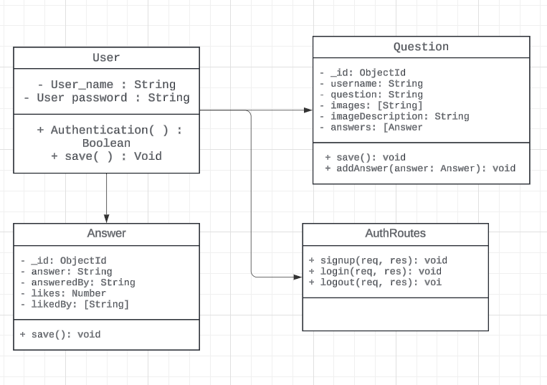
Class Diagram:
UML DIAGRAMS

Slide 7
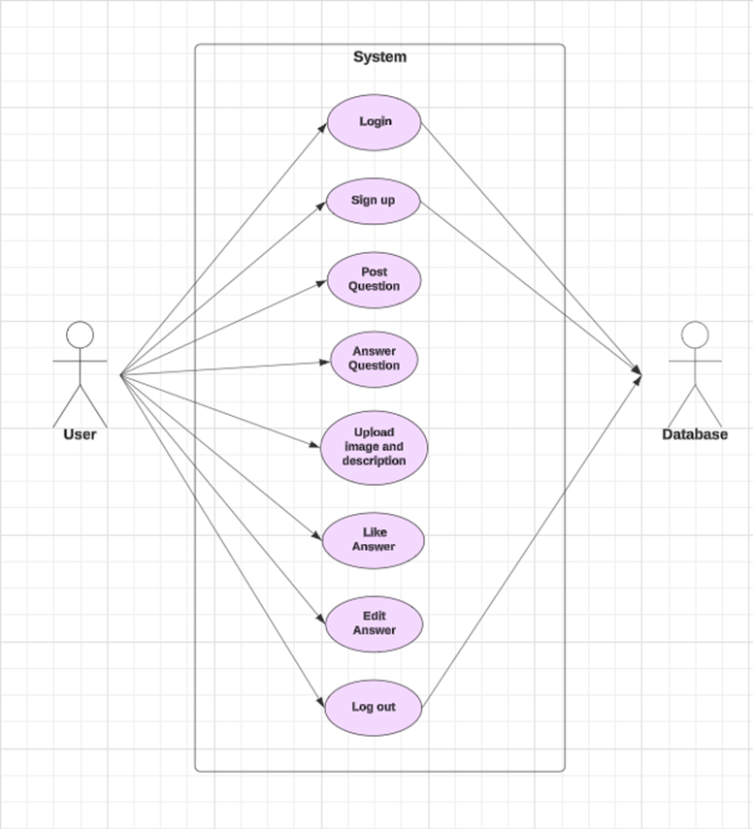
Use Case Diagram :
UML DIAGRAMS

Slide 8
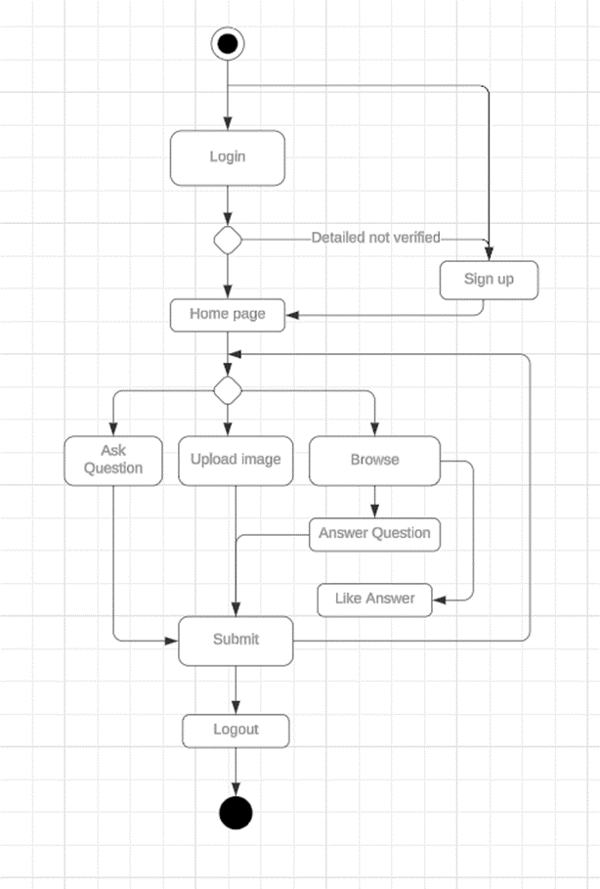
Activity Diagram :
UML DIAGRAMS

Slide 9
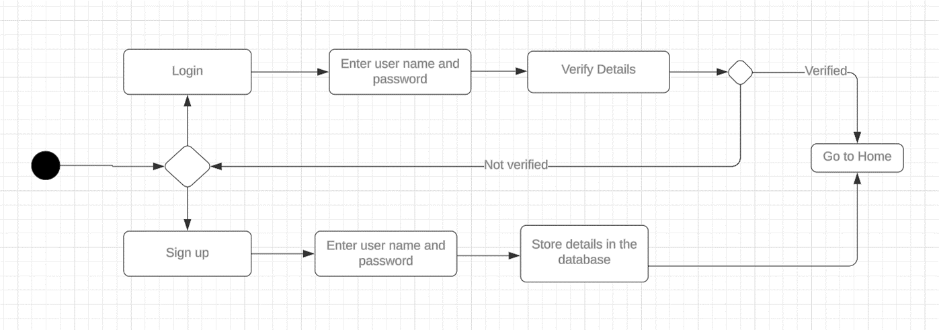
State Chart Diagram :
UML DIAGRAMS

Slide 10
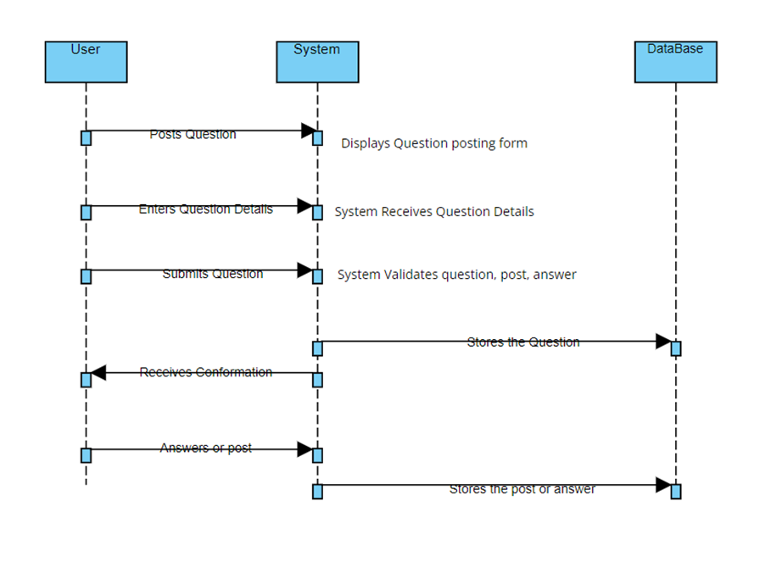
Seqeuential Diagram :
UML DIAGRAMS

Slide 11
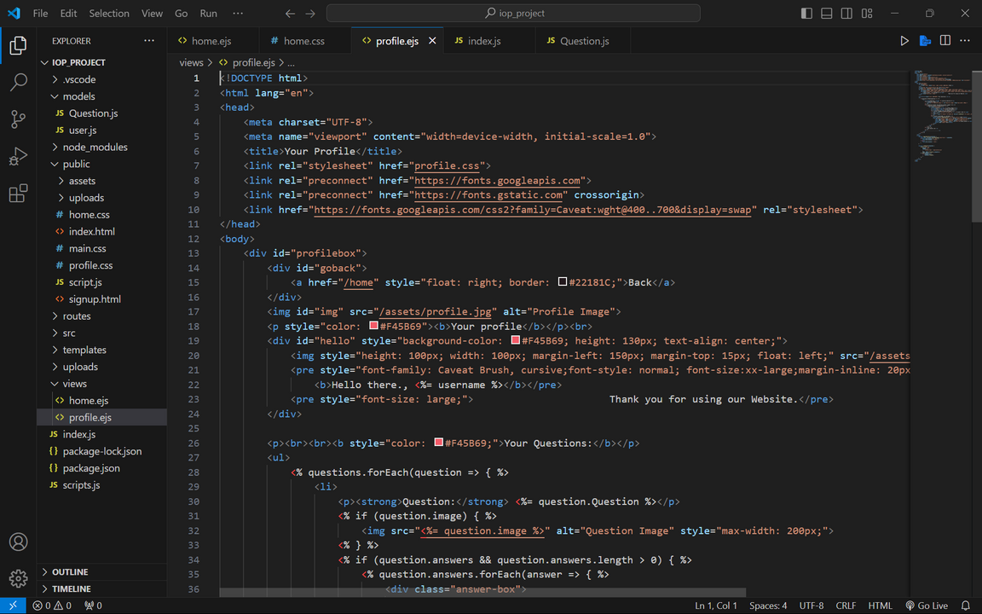
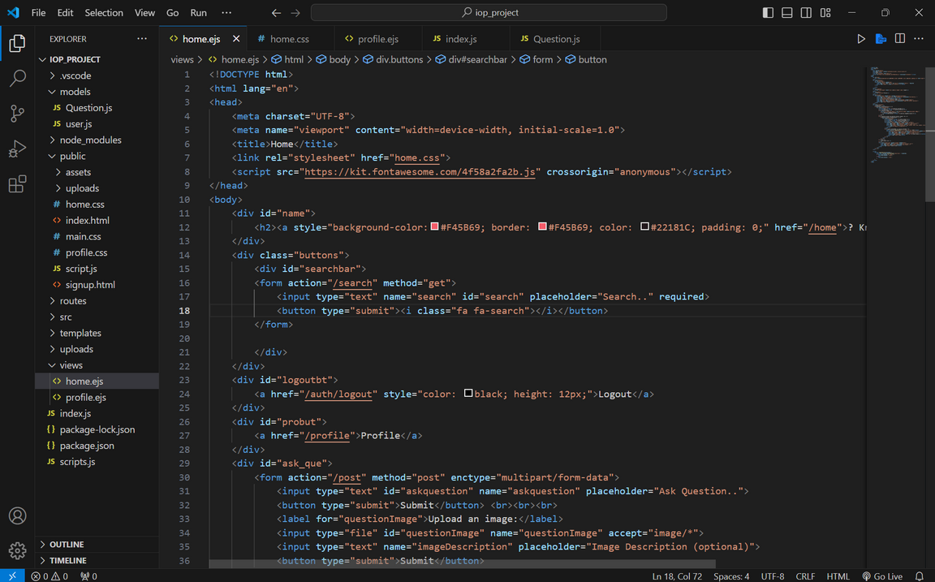
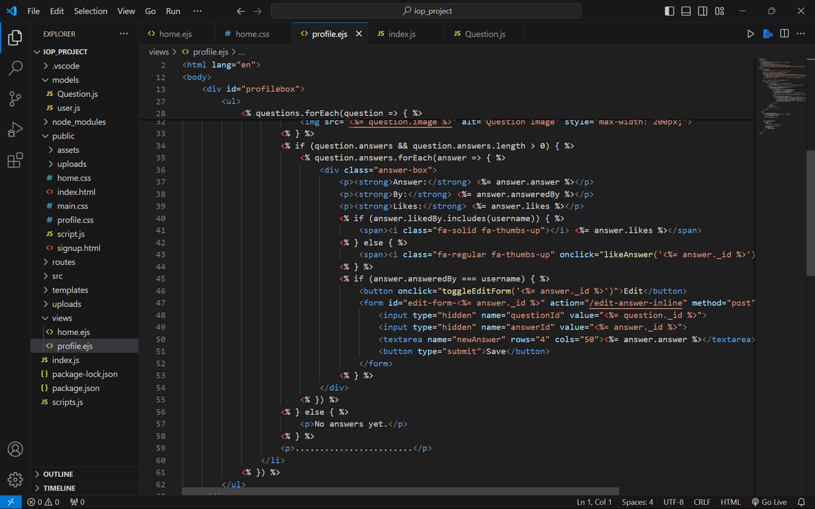
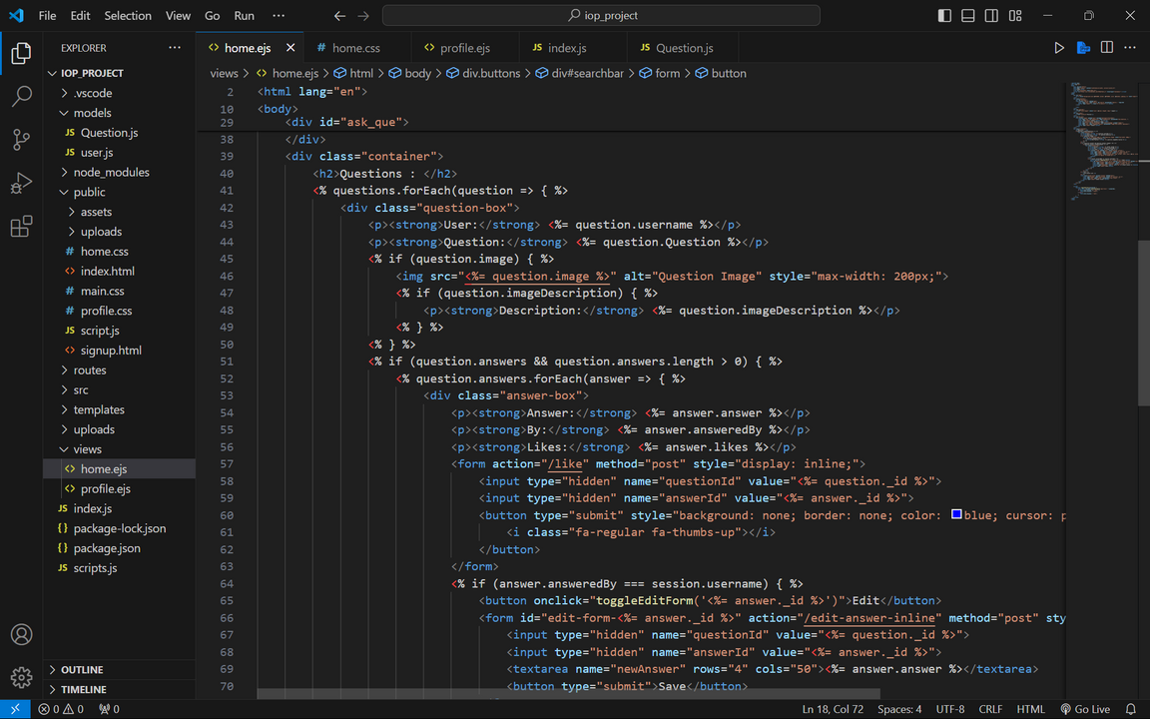
Coding Screen
Frontend

Slide 12
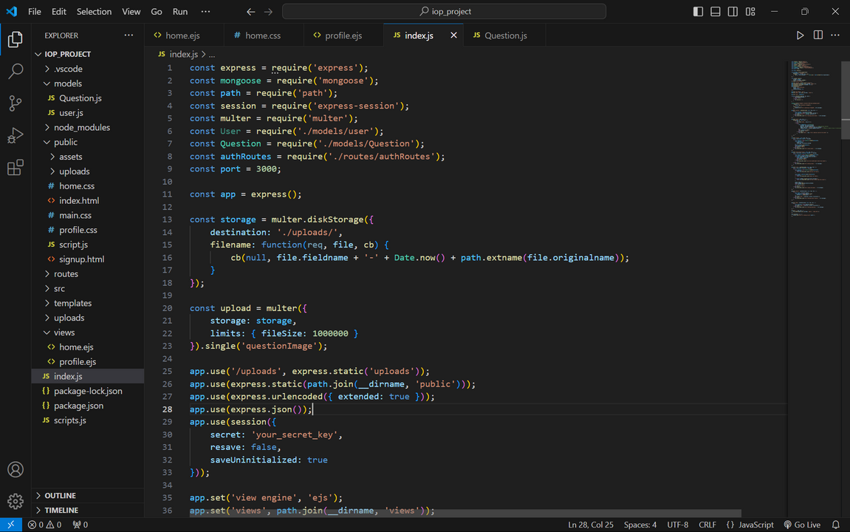
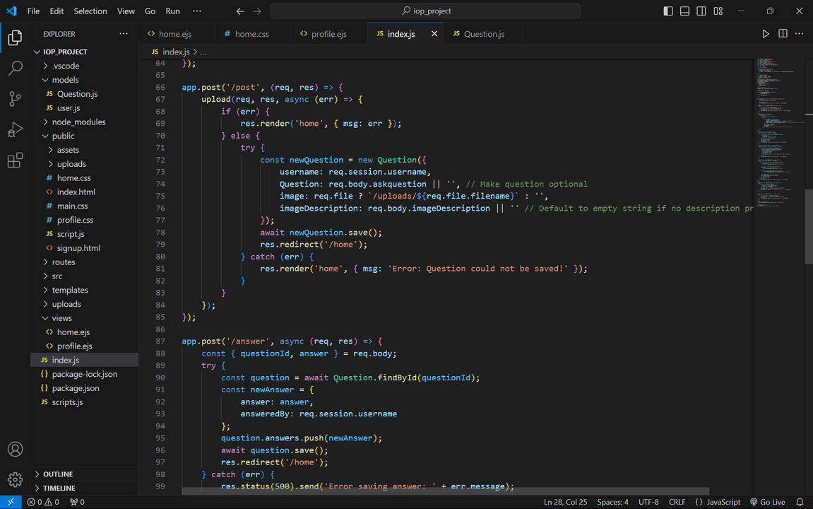
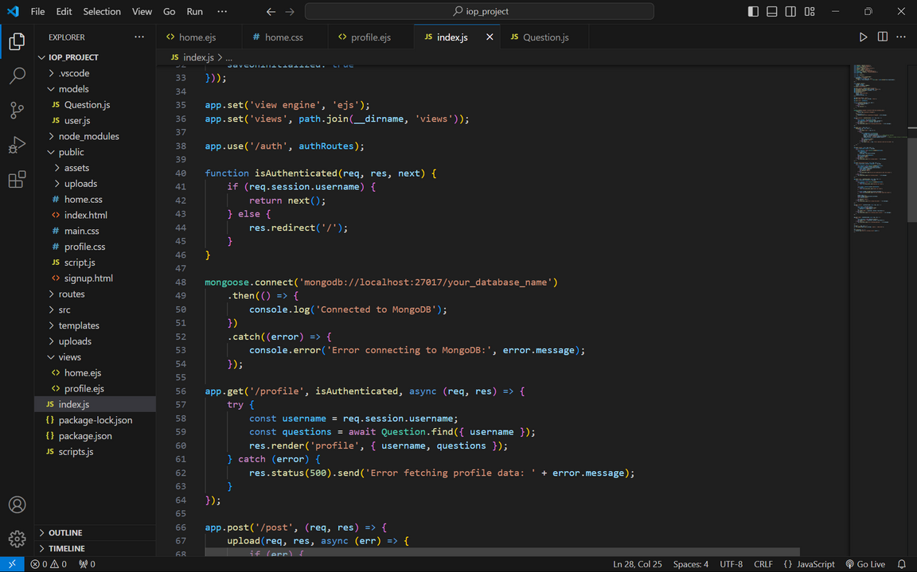
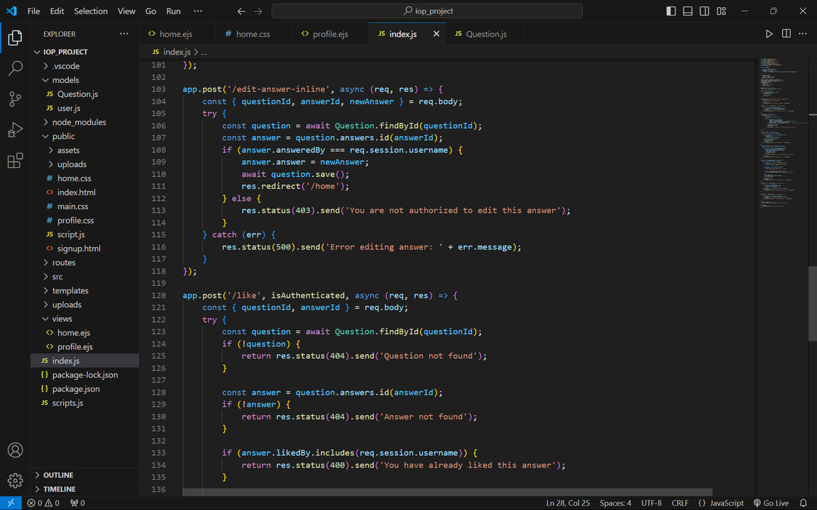
Coding Screen
Backend

Slide 13
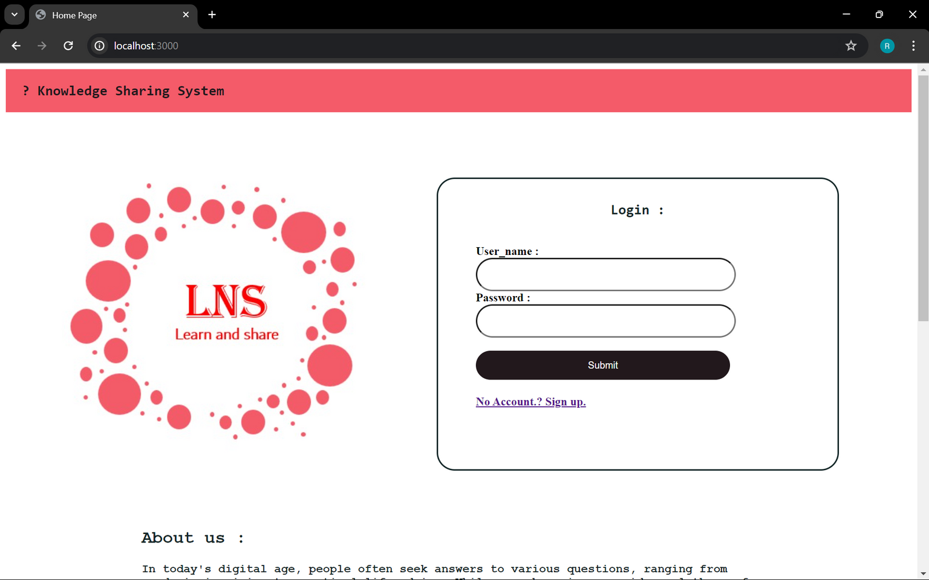
Output :

Slide 14
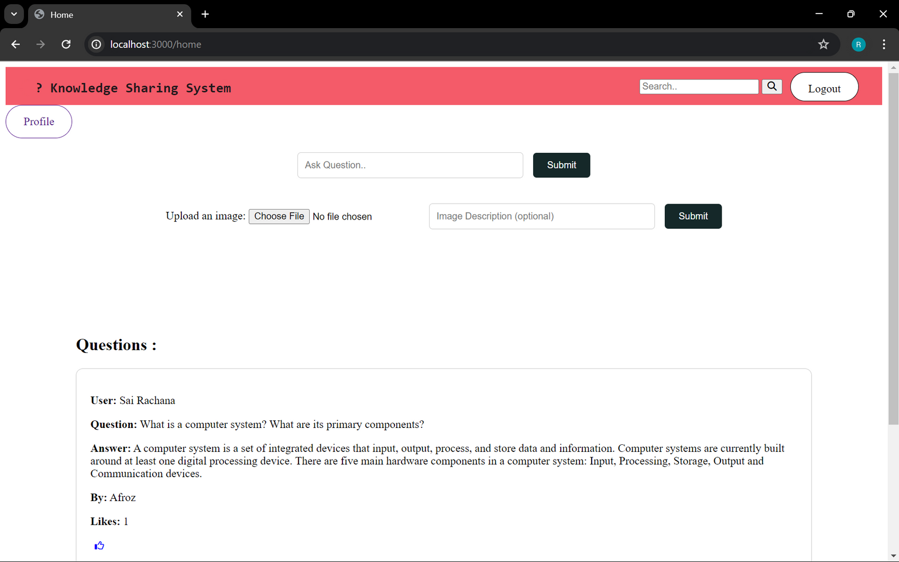
Output :

Slide 15
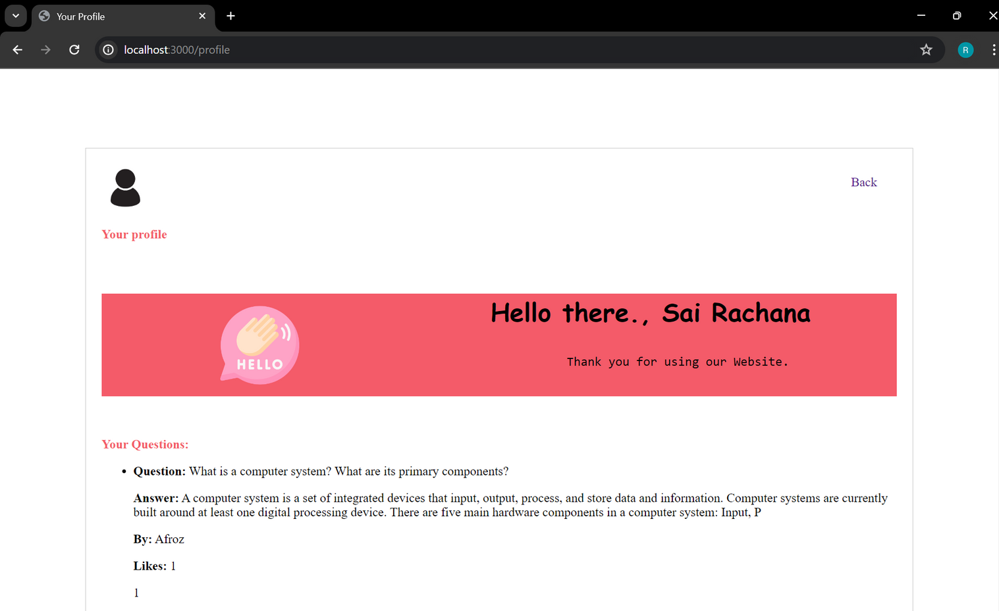
Output :

Slide 16

THANK YOU
Presented by :
22N31A05L7 - Sai Rachana
22N31A05M3 - Afroz
22N31A05P8 - Niharika

